Slide 1
Welcome to my presentation

Slide 2
Management Studies Department
About my Department
The Management Department focuses on developing leaders and managers equipped with strategic, operational, and interpersonal skills. It offers training in key areas like leadership, human resources, and operations to enhance organizational efficiency. Emphasizing ethical practices and social responsibility, the department prepares individuals to make positive business impacts. Additionally, it conducts research to explore new trends and innovations, helping organizations stay competitive and effective.

Slide 3
Opportunity of this department
Leadership roles: finance, healthcare, technology, consulting
Career paths: project management, HR, operations, strategic planning
Networking and internships: industry connections, professional growth
Ethics and CSR: sustainable business demand

Slide 4
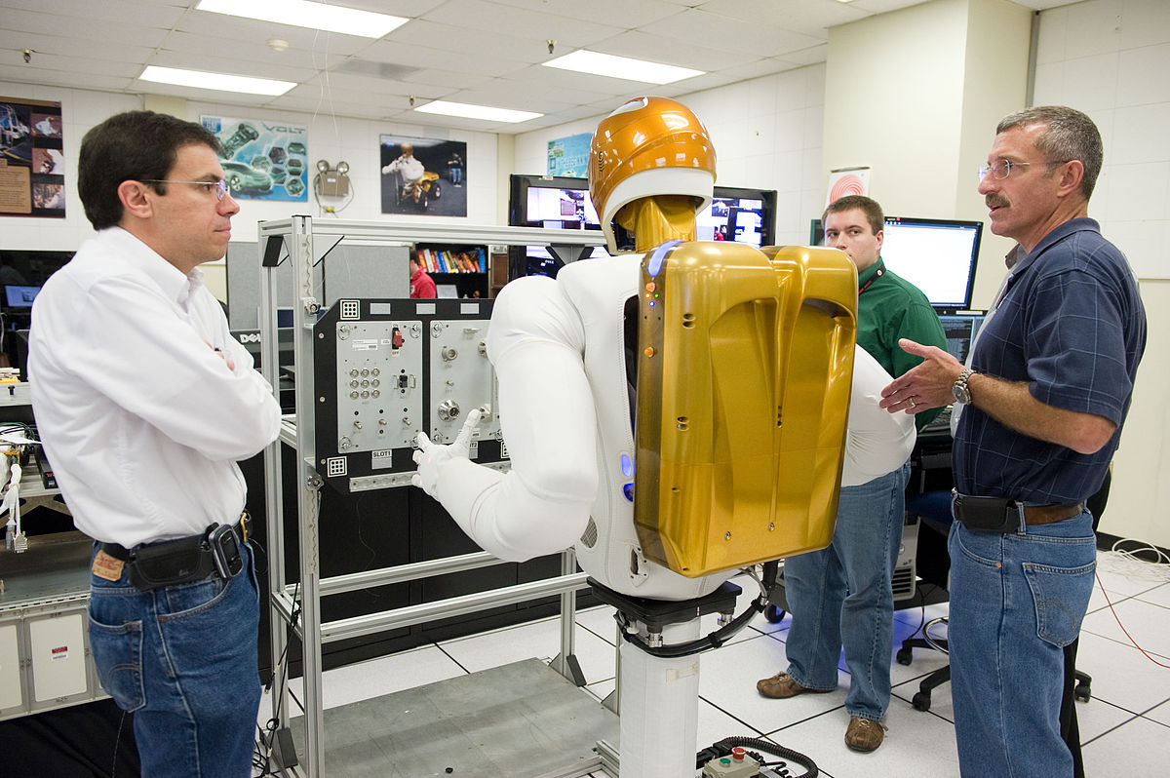
Needed Skills
Leadership skills: inspiring and guiding teams effectively
Communication: clear, persuasive verbal and written abilities
Analytical skills: data analysis, problem-solving, decision- making
Strategic thinking: planning, goal-setting, and long-term vision
Adaptability: flexibility in changing environments
Interpersonal skills: team collaboration, conflict resolution
Time management: prioritization, meeting deadlines
Ethical judgment: understanding and applying ethical standards

Slide 5
Student and teacher ratio

Slide 6
Job field of this department
Human Resources: recruitment, training, employee relations
Operations Management: supply chain, logistics, production
Project Management: planning, execution, and overseeing projects
Consulting: strategy, management, business development
Financial Management: budgeting, financial analysis, investment
Marketing Management: brand strategy, market research, promotions
Entrepreneurship: startup management, business development
Corporate Strategy: strategic planning, mergers, and acquisitions

Slide 7
Class Rome environment
Physical Setup: Arrangement of desks, lighting, and technology (e.g., projectors, smartboards) to support different teaching styles and student needs.
Atmosphere: A welcoming and inclusive atmosphere fosters respect, motivation, and a sense of belonging, helping students feel comfortable to participate.
Interactive Tools: Use of digital tools, visual aids, and hands-on materials to enhance understanding and make learning dynamic.
Rules and Expectations: Clear guidelines and respectful communication that encourage positive behavior and create a structured learning environment.

Slide 8
Thank you everyone

